Slide 1


Using AI for Your Writing: Five Things You Should Know
September 10, 2025
Dr. Jodie Salter (she/her)
jsalter@uoguelph.ca
Writing Specialist
McLaughlin Library

Slide 2

PRESENTATION STRUCTURE
Using AI-generated Content in Your Coursework
Limitations and Concerns
Advice and Strategies
Using AI to Support Your Learning Process
Limitations and Concerns
Advice and Strategies

Slide 3
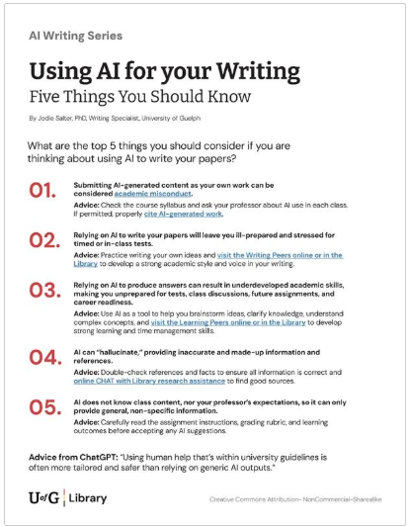
1-page handout on the Library website
https://learningcommons.lib.uoguelph.ca

Slide 4
AI-Generated Content
Be aware of 3 areas of concern when using AI-generated content in your writing…
1
2
3
ACADEMIC MISCONDUCT
FALSE INFORMATION
GENERALIZATIONS

Slide 5

#1 ACADEMIC MISCONDUCT
Submitting AI-generated content as your own work or using it without permission is considered academic misconduct.
Review the University of Guelph Statement on Artificial Intelligence Systems, ChatGPT, Academic Integrity to better understand the rules and recommendations.

Slide 6

#2 FALSE INFORMATION
AI can “hallucinate,” providing inaccurate and made-up information and references.

Slide 7

#3 GENERALIZATIONS
AI does not know class content, nor your professor’s expectations, so it can only provide general, non-specific information.

Slide 8

Advice for Using AI-generated Content in Your Coursework
For every class, check the syllabus and ask your professor about AI use.
Use online CHAT with Library research assistance to find good sources before turning to AI.
If AI use is permitted, properly cite AI-generated work.
Before accepting any AI suggestions, carefully read the assignment instructions, grading rubric, and learning outcomes.
Double-check references and facts to ensure all information is correct.

Slide 9
Your Learning Process
If you begin to rely on AI to do your assignments and coursework for you, this shortcut to learning will negatively impact 2 key areas of growth:
1
2
ACADEMIC SKILLS
INTELLECTUAL DEVELOPMENT

Slide 10
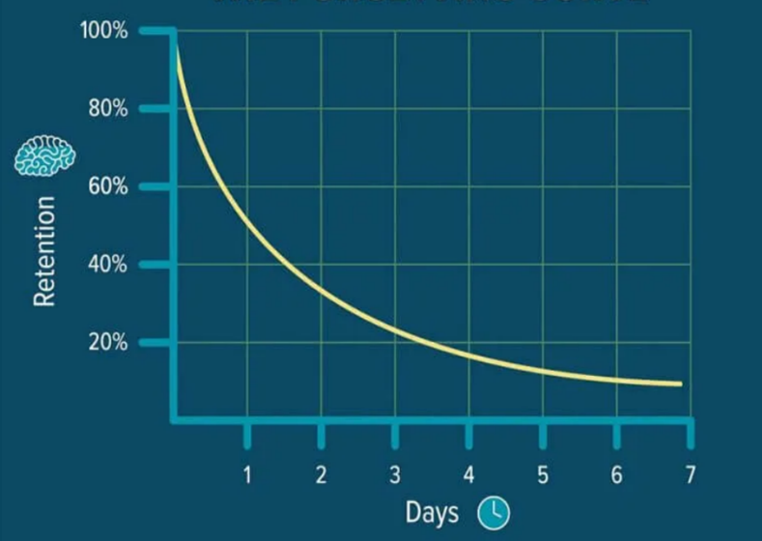
Study 1: The Ebbinghaus Curve of Forgetting
Without active and repeated engagement with new information, we forget approximately
50% of what we learn within an hour
75% within a day
90% within a week
Image: The Ebbinghaus’s Forgetting Curve | by Learning to learn better | Medium

Slide 11
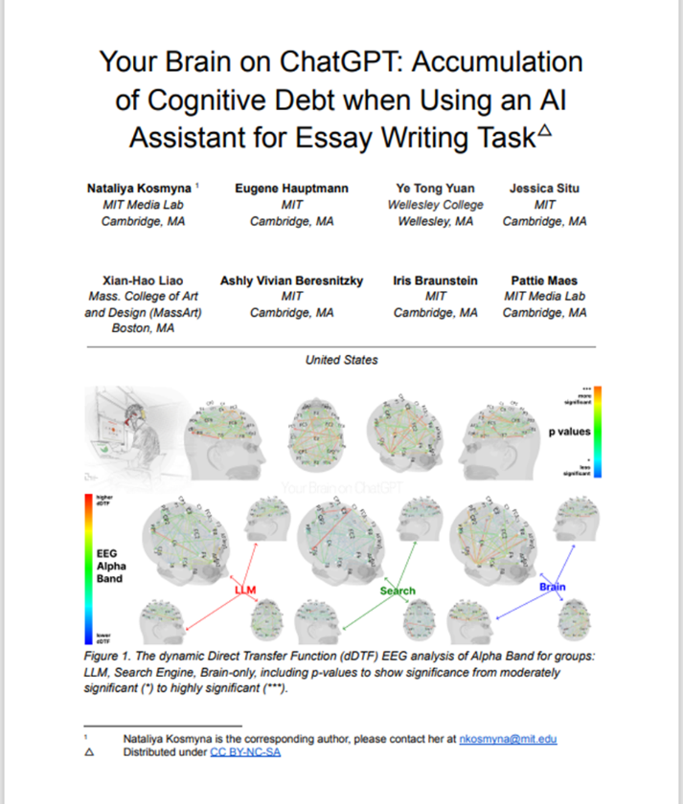
Study 2: Your brain development on ChatGPT
A 2025 study from MIT used EEGs to compare the brain activity of students who used GenAI to write essays and students who didn’t use AI assistance.
After four months, EEGs revealed significant differences.
GenAI users showed
weaker brain activity,
55% decreased neural connectivity,
and substantially lower memory recall
Source: https://www.brainonllm.com/

Slide 12

#4 ACADEMIC SKILLS
Short-term: relying on AI to write your papers will leave you ill-prepared and stressed for timed and in-class tests and exams.
Longer-term: without practicing your writing skills, you will underdevelop your ability for organization, complex thinking, and communication, all of which are essential for your academic path and future career success.

Slide 13
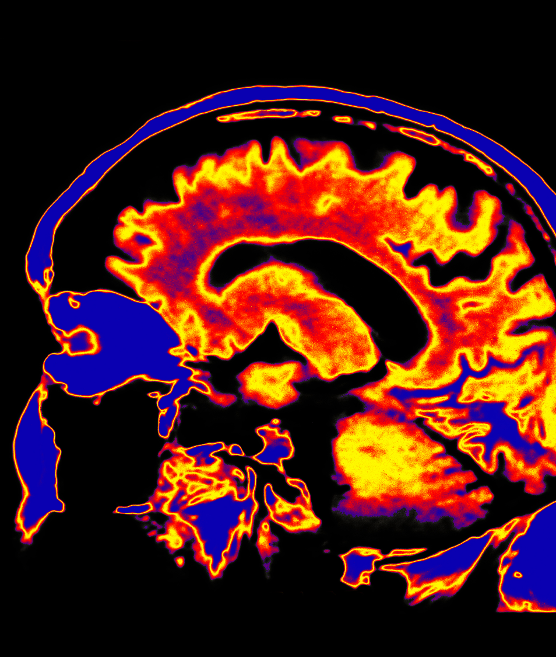
#5 INTELLECTUAL DEVELOPMENT
Relying on AI to produce answers makes you unprepared for tests, class discussions, future assignments, and career readiness.
The learning process requires us to stretch beyond our comfort zone and challenge ourselves, so new neural connections in our brain fire and develop more complex thinking.

Slide 14

Advice from ChatGPT:
“Using human help that’s within university guidelines is often more tailored and safer than relying on generic AI outputs.”

Slide 15

Advice for Using AI to Support Your Learning Process
Use AI as a tool to help you brainstorm ideas, clarify knowledge, and understand complex concepts.
Practice writing your own ideas before prompting AI.
Meet with a Writing Peer or TA in the Library to get started, brainstorm your topic, strengthen your paragraphs, organize your essay structure, and develop your own strong academic writing style.
Meet with a Learning Peer in the Library to develop strong learning and time management skills.

Slide 16

Don’t let AI take your University of Guelph degree from you!

Slide 17

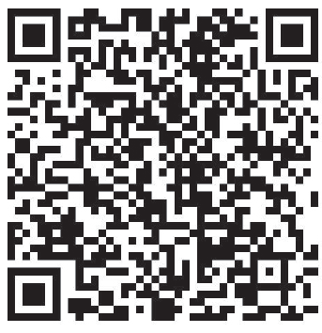

QUESTIONS?
Dr. Jodie Salter
jsalter@uoguelph.ca
Book an Appointment

Slide 18

Creative Commons License

